Slide 1
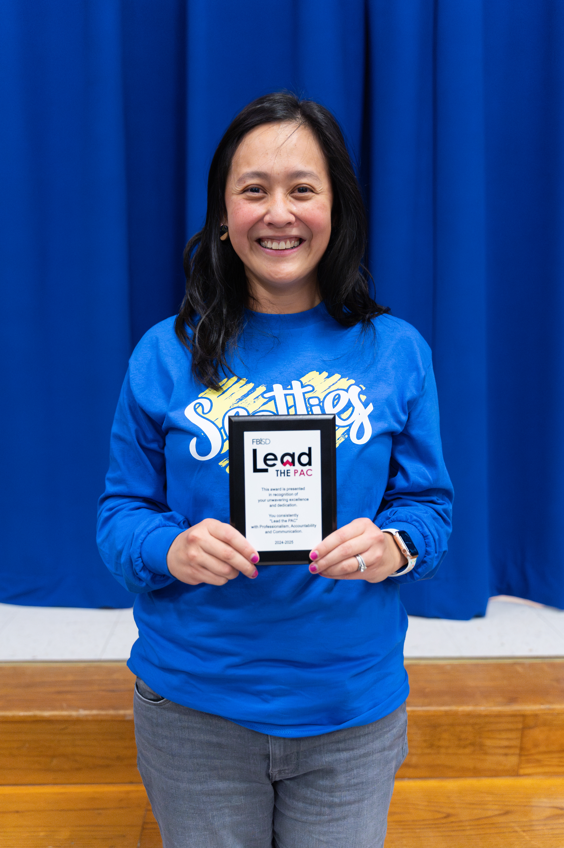
Meet the Counselor
2025-2026
Welcome Highlands parents and Guardians!

Slide 2
About the Counselor – Mrs. Angela Hsu
Education:
Clements High School
UT-Austin (B.S. Elementary Education)
University of Houston (M.Ed. Counseling)
Work:
20th year in Fort Bend ISD (taught for 11 years)
9th year as school counselor
Licensed Professional Counselor
Won the February 2025 FBISD PAC Award
Personal:
Parents from Taiwan
Speak conversational Mandarin Chinese
Husband and I have a daughter, Sophia who is 3 years old

Slide 3

Counseling curriculum
We follow the American School Counseling Association (ASCA) model, which include:
  Guidance Curriculum – all students, Core Essential Values
  Responsive Services – intervention
  Individual Planning – managing & planning goals
  System Support – staff, parents, community
Notes:
Guidance Curriculum - In an effort to help students develop competence in essential life skills
Responsive Services - Provide intervention for immediate personal/social/emotional concerns
Individual Planning - Provide guidance to help students plan, monitor, and manage their personal, educational and career goals, and facilitate transition activities for post-secondary education and/or training
System Support - Support campus staff, parents, and community to promote the educational, career, personal, and social development of students, as well as the Developmental Guidance Program

Slide 4
Services provided
Guidance lessons during Outclass or in classrooms about:
  Bullying prevention, anti-victimization, social media / internet safety
  Core Essentials (character education that aligns with the FBISD profile of a graduate)
Small group work and one-on-one counseling with students
Gifted & Talented testing and referral assistance
Referral for outside resources: therapists, psychologists, psychiatrists
Consultation with parents and/or teachers
Notes:
One-on-one counseling: 4-6 session per semester and then will re-evaluate based on counselor feedback – goal of school counseling: acclimate student back into the classroom, is this a problem that affects school behavior, social well-being?
Support groups for grief, divorce/family changes, social skills, making new friends / adjusting to school – 4 to 6 sessions
Parent permission is required before working with students – you will be in the know!
Classroom observations of students per request of parent, teacher, staff member – to provide more information from a different perspective, data use for student referral meetings with Campus Compliance Coordinator for students to be tested, 504, SPED, etc.

Slide 5
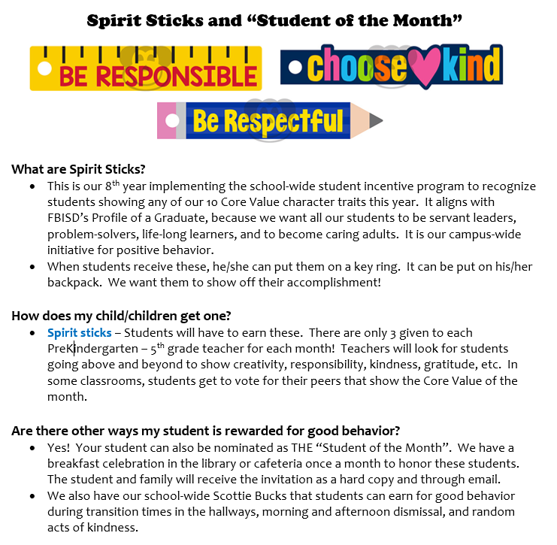

Slide 6
Additional Services
New student Lunch Bunch
National Elementary Honor Society: 5th graders
“No Place for Hate” school-wide events
“Girls on the Run” Program for 3rd-5th grade girls (6 years, on a break this school year)
Career Day – end of January
“Student of the Month” breakfast celebrations
Notes:
Asking for volunteers ahead of time – end of January! ☺

Slide 7

Needs Assessment for 3rd- 5th graders
Purpose:
  Opportunity for students to share thoughts & feelings
  Focus small group and whole group classroom lessons
  Direct student feedback on guidance lessons
  Extra: Minute Meetings for all PreK-1st graders

Slide 8
Bullying
Bullying – unwanted aggressive behavior through verbal, written, or electronic expression. It can occur on campus or off-campus, school-related events, or a vehicle operated by the district -- including cyberbullying.
1. Done on purpose
2. One-sided
3. Target feels scared or intimidated by aggressor
4. Happens repeatedly but can ALSO happen ONE time
* Must meet all 4 of these criteria during investigation to qualify as bullying

Slide 9

It takes a team!
If your child comes home telling you he/she is being bullied, some helpful questions to ask with the 4 criteria in mind:
What happened beforehand?
  (To determine one-sided or mutual hurtful behavior)
How are you feeling about that person?
  (To determine if your child is intimated/scared or hurt/offended)
I’m here to help. Have you told the person to stop assertively – in a clear and firm way?
  (To determine problem solving steps: ignoring, telling the other person to STOP, asking teacher for help, asking counselor for help)
Notes:
If your child is still friends with the person (even after mean comments, exclusion, etc.), it would be a good idea to go over healthy expectations of a friend.

Slide 10

Bullying allegations
Brought to our attention via student, parent, teacher, staff member, or bus driver
Counselor will talk with target and see what happened
Assistant principal will continue the investigation, send parent rights home, and notify parents
If bullying is warranted, a stay-away agreement for both parties are signed.
Notes:
Questions on bullying or services provided?

Slide 11



National Association for Gifted Children (NAGC)
Students with Gifts and Talents:
  Come from all racial, ethnic, and cultural populations, as well as all economic strata.
  Require sufficient access to appropriate learning opportunities to realize their potential.
  Can have learning and processing disorders that require specialized intervention and accommodation.
  Need support and guidance to develop socially and emotionally as well as in their areas of talent.
  Require varied services based on their changing needs.

Slide 12

Texas Education Agency (TEA)
The Texas Education Agency defines a gifted/talented student as a child who performs at or shows the potential for performing at a remarkably high level of accomplishment when compared to others of the same age, experience, or environment and who:
  exhibits high performance capability in an intellectual, creative, or artistic area;
  possesses an unusual capacity for leadership; or
  excels in a specific academic field.
  (Texas Education Code §29.121)

Slide 13
FBISD Gifted and Talented (GT) Areas Served
FBISD Gifted and Talented Student
English Language Arts
Mathematics
Social Studies
Science
Students can be served in:
ELA/Social Studies
OR
Math/Science
OR
All (4) areas
Notes:
Your child is identified in either Math and Science, ELA and SS, or all areas. Your child’s teacher in these subject areas will provide additional differentiation according to your child’s needs.

Slide 14
Gifted & Talented (GT) Referral / Testing
Important link: *
Online referral system: https://gt.fortbendisd.com/
You MUST have a Skyward login and password to access the online GT referral form. If you do not have one, you can visit here to register: https://www.fortbendisd.com/family-access
Notes:
Show parents how to get to the website

Slide 15
Gifted & Talented (GT) Referral / Testing/Process
The gifted and talented referral window is now open until Tuesday, Sept. 30th. Hard deadline -- There are no exceptions.
Online referral system: https://gt.fortbendisd.com/
Parents/Families will be asked to complete a Home Rating Scale (SIGS) DURING the time of referral. Please give your input!
Universal screener/GT testing window for 2nd grade is October 27th – 31st
Kindergarten, 1st, 3rd-5th grade – November 3rd – 14th
Notification emailed out in March for all grade levels & Kindergarten GT services begin on March 1st, 2026
Notes:
Must have a Skyward login and password to log onto the referral system. All GT tests will be done online this year.
If your child is already identified in 1 area for GT, you will not test until the Spring. It is considered a re-assessment, so parents/guardians will have to pay for it via RevTrek – last year it was $50
Kindergarten & 1st grade GT tests are untimed, all instructions are read aloud & the entire tests consist of pictures. We spread it out for 2 days to fight testing fatigue. 3rd – 5th grade: each of the 9 sections are timed, with a few planned breaks in between – the test usually lasts for about 2-2.5 hours

Slide 16
2nd grade Universal Screener
2nd graders (who are not currently identified for GT services) in Fort Bend ISD will take the Cognitive Abilities Test (CogAT) during the universal screener window: October 27th – 31st
Test is untimed; self-paced and by GT administrator instruction
All directions are read aloud to students & directions can be given in Spanish, if needed.
Notes:
Must have a Skyward login and password to log onto the referral system; even though all 2nd graders take the test, you will get an opportunity to complete the home survey sooner rather than wait for test results to complete the survey.
On our school website, under the “Counseling tab”, “Gifted & Talented” tab on the left– This same information so that you can navigate at home

Slide 17

GT Assessment
Quantitative Measures
CogAT (Nonverbal Assessment) - measures a student’s reasoning abilities using visuals/pictures.
CogAT (Verbal Assessment) - measures verbal aptitude, word knowledge and concepts, facility with language, verbal reasoning, and analogies.
CogAT (Quantitative Assessment) - measures mathematical reasoning and problem solving, numerical sequences and patterns, manipulation of mathematical concepts.

Slide 18

GT Assessment
Qualitative Measures—input from those who know the student
Parent Inventory
Teacher Inventory

Slide 19

GT Services K-12
GT services provided in all core subject areas—ELA, Social Studies, Math and Science
(Secondary—AAC and AP courses)
GT students cluster grouped with GT-trained teachers
GT Learning Plans
Completion of Texas Performance Standards Project (TPSP)/Innovation Hour Project (Required in grades 1-10, highly encouraged in grades 11-12)

Slide 20

GT student grouping
Every campus is required to have at least 1 of these three models.
Designated GT classroom – 100% of class is all GT
GT Cluster – minimum of 6, maximum of 12 GT students
Modified GT Cluster – there are fewer than 6 GT identified
Notes:
With Highlands’s GT population, we would fit under the GT cluster and modified GT cluster

Slide 21
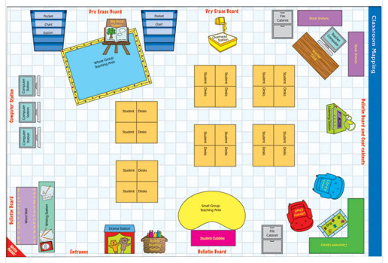
Cluster Grouping
http://designslist.com/designs/classroom-map-designs.html

Slide 22
Big Question: How do we prepare our child for the test?
There is no true way to prepare for the Cognitive Abilities Test, or CogAT.
  Be wary of companies that guarantee identification.
Giftedness is a natural ability. They either are gifted or they aren’t.
  Only 3-5% of the population are truly gifted.
Most of our referred students are high-achievers, not gifted.
  Pre-AP classes in MS and HS are open to all students, not just those with needing gifted services.

Slide 23

Dr. Laurie Westphal (Director)
Anela Williams (Elementary Program Manager)
Aisha Coleman-Holmes (Secondary Program Manager)
Terry White (Curriculum Integration Coordinator)
Nancy Bryant (GT Mentorship Specialist)
Joseph Bernhart (GT Academy Coordinator)
FBISD Gifted and Talented Department

Slide 24
Questions?
THANK YOU for attending! Please feel free to email privately. ☺
Angela.Hsu@fortbendisd.gov
Minnie.Cheng@fortbendisd.gov

